Slide 1

VahanBazar
Your Ultimate Destination for Two-Wheeler Trading

Slide 2

Smart Search, Smarter Choices
Browse with Confidence
Discover thousands of two-wheelers with our intelligent search system. Filter by brand, price range, fuel type, and mileage to find your perfect match in seconds.
Advanced filtering options
Real-time inventory updates
Verified seller profiles

Slide 3

Compare Before You Choose
Brand Analysis
Fuel Efficiency
Performance Metrics
Compare top manufacturers side-by-side with detailed brand histories and reliability ratings.
Analyze real-world mileage data and fuel consumption patterns from verified owners.
Review kilometers driven, maintenance records, and performance history for informed decisions.

Slide 4

Financial Planning Made Simple
EMI Calculator
Calculate affordable monthly payments with our smart EMI tool. Input your down payment, loan tenure, and interest rate to get instant results.
Fuel Cost Analyzer
Estimate your monthly fuel expenses based on your riding patterns, fuel type, and current market prices.

Slide 5
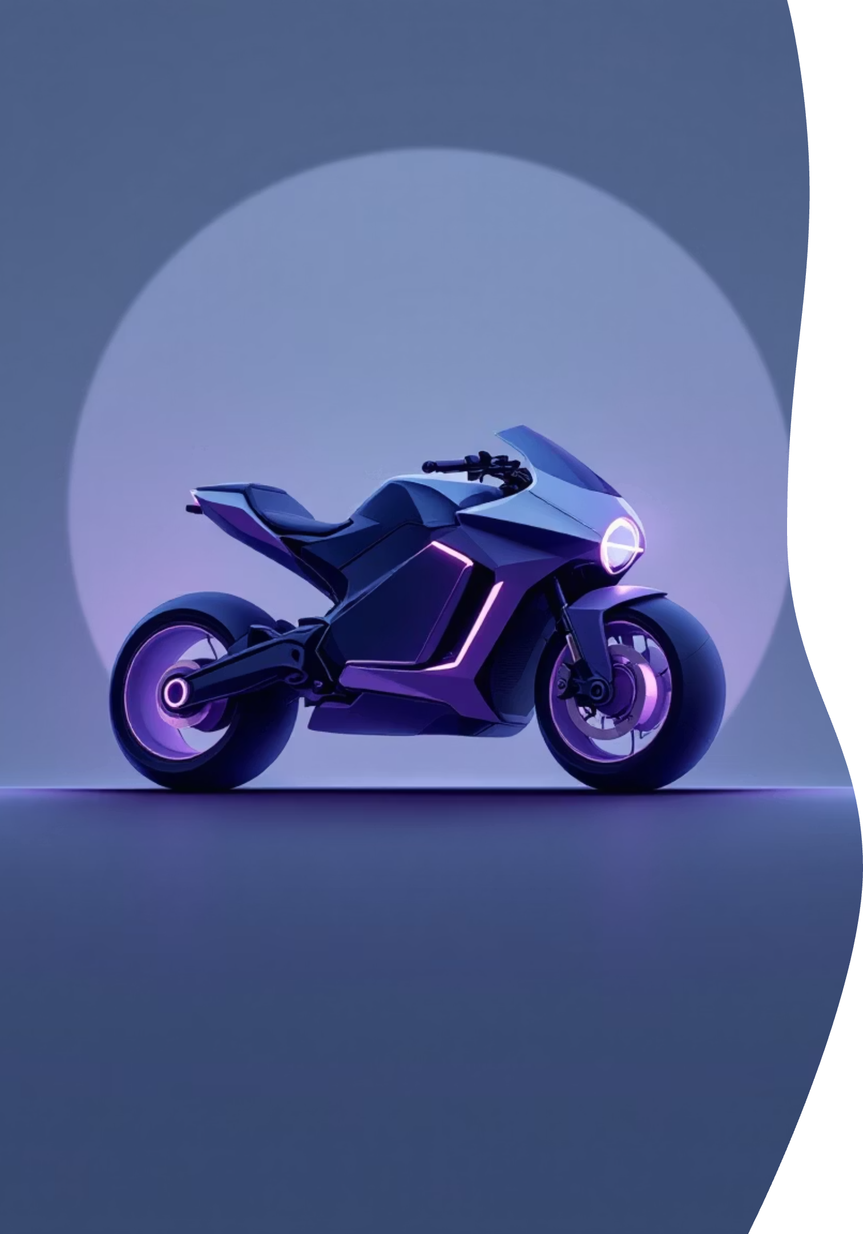
What's Coming Next
1
Q1 2024 Launches
Upcoming electric scooters and hybrid motorcycles from leading manufacturers hitting the market.
2
Mid-Year Releases
Sports bikes and premium touring motorcycles with advanced connectivity features.
3
Year-End Debuts
Next-generation fuel-efficient models and cutting-edge electric vehicles.

Slide 6




Test Ride at Your Convenience
Find Nearby Showrooms
Locate authorized dealers and showrooms in your area with our interactive map feature.
Book Your Test Ride
Schedule test rides at your preferred time slots through our easy online booking system.
Expert Guidance
Get professional advice from certified technicians and sales experts during your visit.

Slide 7

AI-Powered Photo Authentication
Revolutionary Security
Our advanced AI detection system ensures every uploaded photo is authentic and unaltered.
Real-time image verification
AI-generated content detection
Automatic fake photo rejection

Slide 8
Building Trust Through Technology
01
02
Image Upload
AI Analysis
Sellers upload high-quality photos of their two-wheelers through our secure platform.
Our machine learning algorithms scan for authenticity, editing, and AI-generated content.
03
04
Verification Result
Buyer Confidence
Only genuine, unaltered photos pass our screening and get published on the platform.
Customers shop with complete trust, knowing all listings feature authentic vehicle images.

Slide 9

Technical Foundation
Frontend Development
Backend Infrastructure
React.js for responsive user interface, ensuring seamless experience across all devices and browsers.
Node.js and MongoDB for robust data management, secure transactions, and scalable performance.
AI Integration
TensorFlow and computer vision APIs for image authentication and fraud detection capabilities.

Slide 10

Ready to Transform Two-Wheeler Trading?
For Buyers
For Sellers
Find verified, authentic two-wheelers with complete transparency and confidence in every purchase.
Reach genuine buyers quickly with our trusted platform and comprehensive seller support system.
For Partners
Join our network of authorized dealers and expand your business reach through digital innovation.
VahanBazar - Where Trust Meets Technology

